Slide 1
Software Testing
Testing Fundamentals -1
By
Ning Chen, Ph.D.
Professor
Department of Computer
Science
California State University,
Fullerton
© Ning Chen, 2017
*

Slide 2
Module Objectives
This module focuses on the fundamental knowledge of software testing.

Slide 3
Fundamentals of Testing
Definition of the term “Testing”
Motivation of Software Testing
What is Software Testing
Software Testing Process

Slide 4
Definition of Testing
Dictionary Definition:
testing
adjective
revealing a person's capabilities by putting them under strain; challenging "it's been quite a testing time for all of us“ by Oxford Dictionaries

Slide 5
Definition of Software Testing
Software Testing Definition:
According to IEEE Standard 829-2008:
Software testing: (1) An activity① in which a system or component is executed under specified conditions, the results are observed or recorded, and an evaluation② is made of some aspect of the system or component. (2) To conduct an activity as in (1).

Slide 6
Definition of Software Testing
① An activity – This pretty much fits into the dictionary definition (by putting it under strain; challenging - which is an activity)
② An evaluation – This is the part that somehow is implicit in the dictionary definition. The professional definition spells it out explicitly.
② Don’t overlook the evaluation part. It may become much deeper than you expect. How to come up with a proper evaluation? How do you know your “proper evaluation” is proper? How do you assure that you do have a proper evaluation? You will encounter other terminologies when you dig in, for example, Verification and Validation, Software Quality Assurance, Software Quality Control, etc.

Slide 7
Motivation of Software Testing
Software is a necessary part of society
  Software that does not work correctly can cause significant undesired effects (loss of money, time, even death…)
It has a role in Software Development, Maintenance, and Operations
It improves software’s Quality

Slide 8
What is Software Testing
Terms
  error, mistake, bug, defect, failure
An error/mistake by a developer produces a bug (defect).
A bug/defect gets executed, the system may (or may not) work and causes a failure

Slide 9
Some Software Testing Principles
Testing shows presence of defects
Exhaustive testing is impossible
Early testing
Defect clustering
Testing is context dependent
Absence-of-errors fallacy

Slide 10
Software Testing Process
Test planning and test control (monitoring the plan)
Test analysis and design
Test implementation and execution
Test evaluation (exit criteria and reporting)

Slide 11
Software Development Models
V-model (sequential development model)
Iterative-incremental development models

Slide 12
Software Testing Models
Testing does not exist in isolation and test model mirrors to software development model.
  V-Model
  Iterative-incremental development models

Slide 13
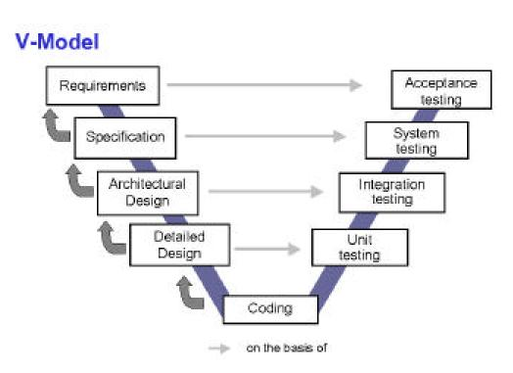
V-Model

Slide 14
Levels of Testing (Where/When to conduct testing)
Unit Testing
Integration Testing
System Testing
Acceptance Testing

Slide 15
How? (how to conduct testing)
White-Box Testing
Black-Box Testing

Slide 16
Do people agree on names?
Specification-Based Testing
Code-Based Testing

Slide 17
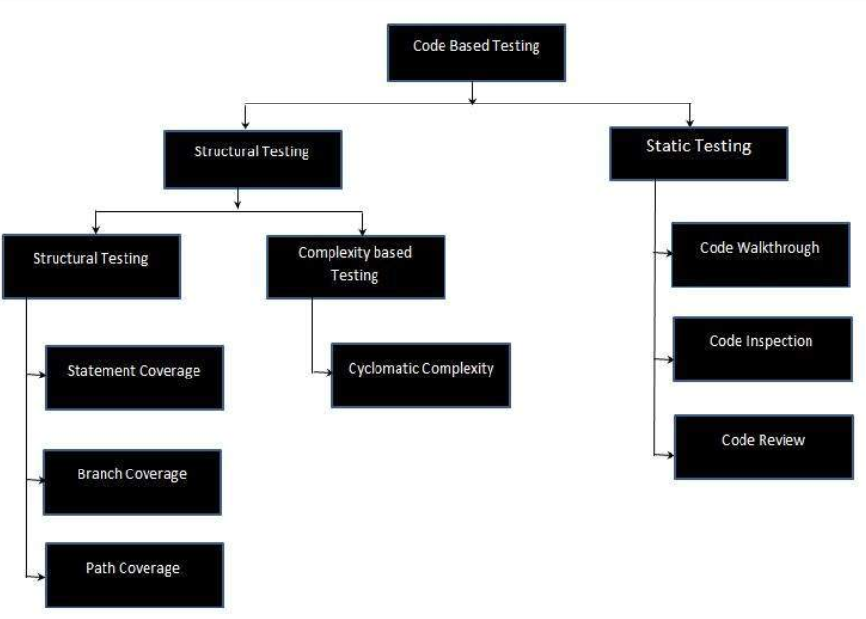
More on Code-Based Testing

Slide 18
Code-Based Structural Testing
Statement coverage
Branch coverage
Path coverage
Cyclomatic complexity

Slide 19
Code-Based Static Testing
Code walkthrough
Code inspection
Code review

Slide 20
Specification-Based
Boundary value analysis
Equivalence partitioning
Decision table
Notes:
Why do we need this test?
don’t have access to source code
Business purpose, they don’t want to review your source code
People won’t be bias. ie. people create a software like their baby, it’s hard to test it by the same person.

Slide 21
Test Management
Test organization
Test planning and estimation
  Test planning
  Entry criteria
  Exit criteria
  Test estimation

Slide 22
Test Management(continue)
Test progress monitoring and control
  Test progress monitoring
  Test reporting
  Test control
Configuration management
Risk management
Incident management

